Slide 1
Vocab Slideshow: List #7
Moon - Paul Jolly - vocab slideshow 7

Slide 2
2 Partners, 1 Computer
Take turns being “driver” and “navigator”
Driver: hands on computer
Navigator: offering input

Slide 3
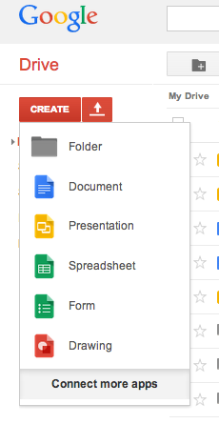
Instructions
Create Google presentation
Title: “class name - your name - Vocab slideshow 7”
Select theme & create title slide
Google search for vocab word; click “images”

Slide 4
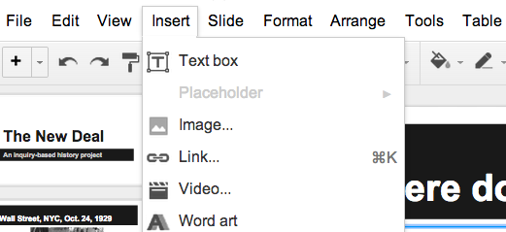
Instructions
Scroll!
Find suitable image
Copy (or save to computer)
“Slide” → “New slide”
“Insert” → “image”

Slide 5
Layout
Word & definition at top
Image
Sentence with word in context at bottom
Repeat for all 5 vocab words you’re assigned

Slide 6
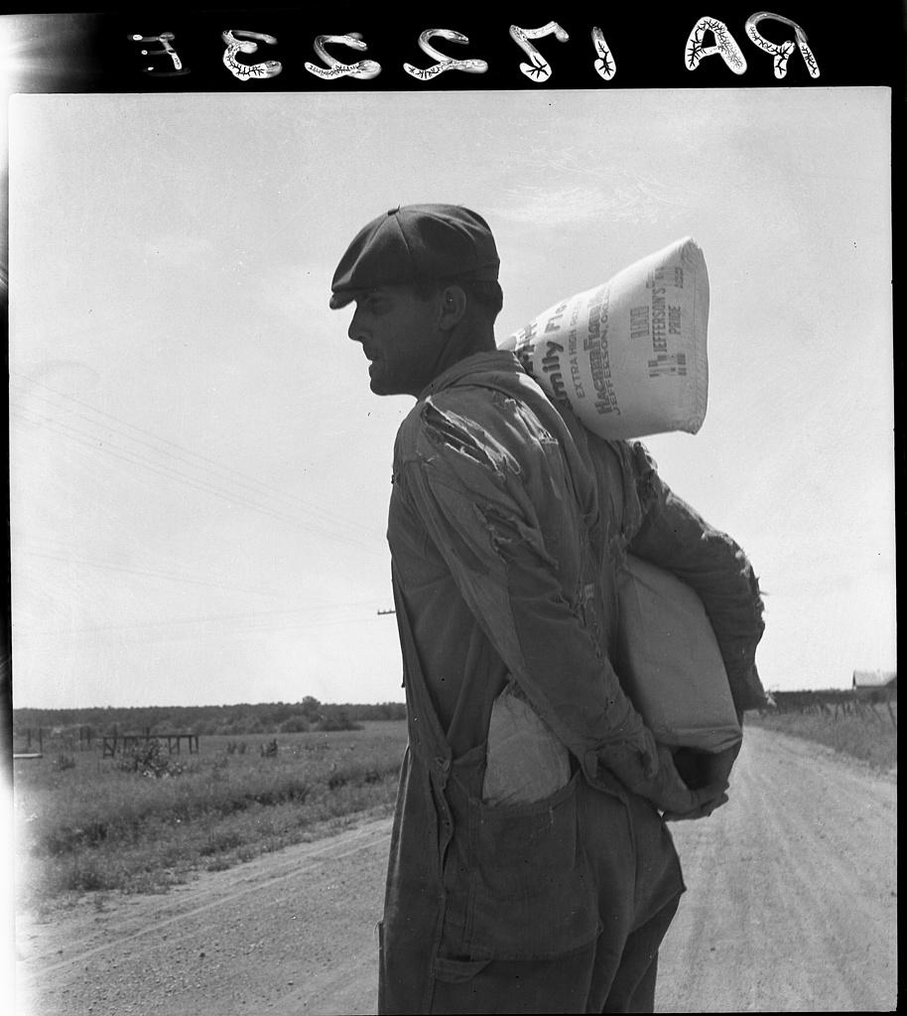
Threadbare: becoming thin and tattered with age
The man’s threadbare clothes showed how poor he had become in the Great Depression.

