Slide 1
Comparative Governments
SYSTEMS FROM AROUND THE WORLD

Slide 2
Essential Question
What are the advantages and disadvantages of the political systems of other nations around the world?

Slide 3
Worldwide Governments
Constitutional Monarchy
Sultanate
Junta – Military Dictatorship
Theocracy
Oligarchy → Tribal, etc
Communism
Socialism
Parliamentary Democracy

Slide 4
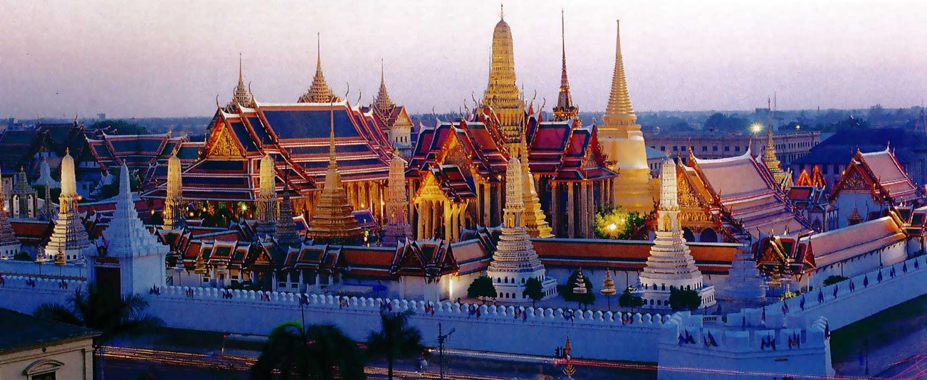
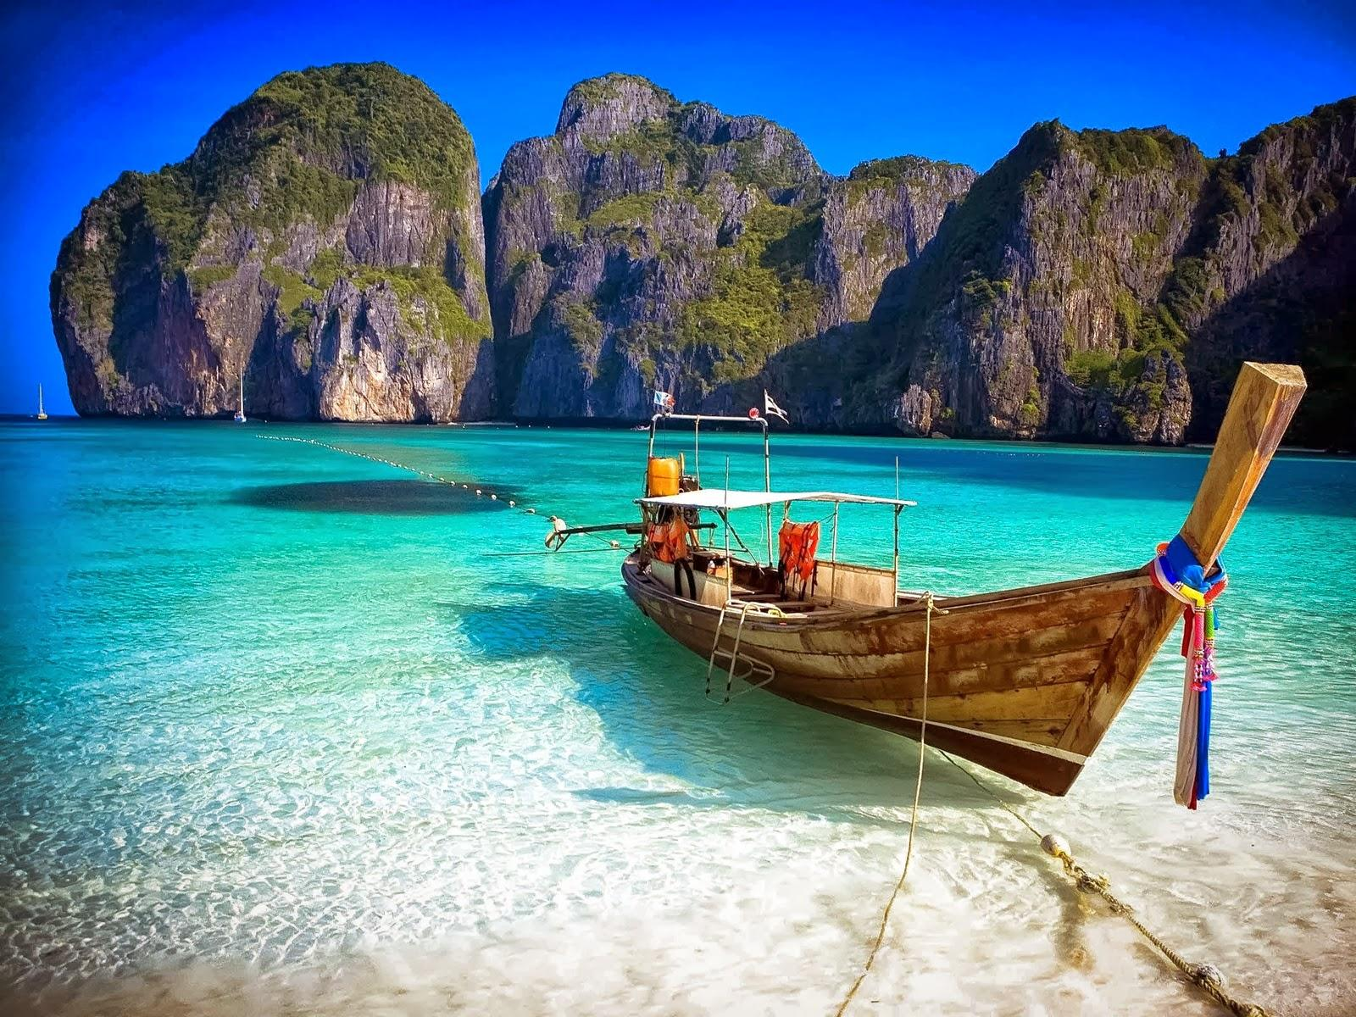
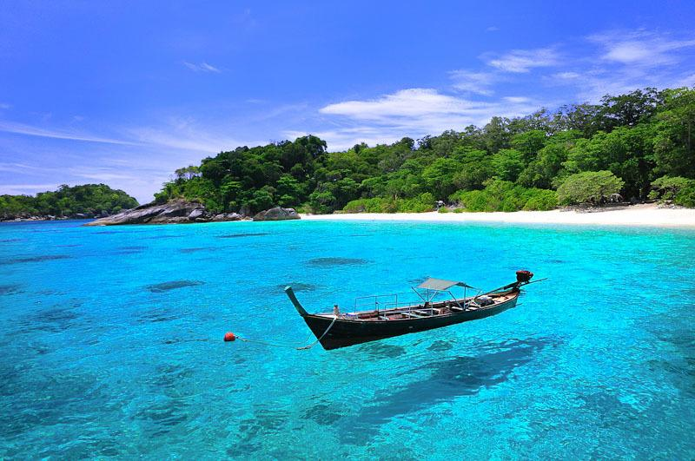
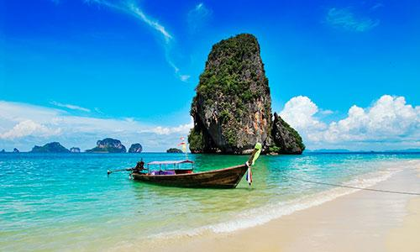
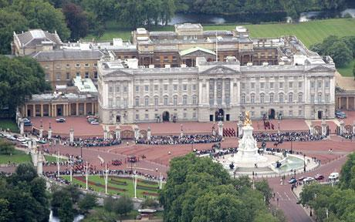
Constitutional Monarchy
Monarch’s power is legally restricted by constitution
Monarch acts as head of state w/no political party affiliation
Great Britain, Denmark, Thailand
Contrast with Absolute Monarchy (‘Divine Right of Kings’)
Saudi Arabia, Qatar, Vatican City

Slide 5
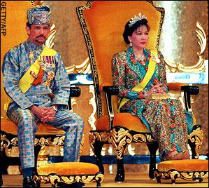
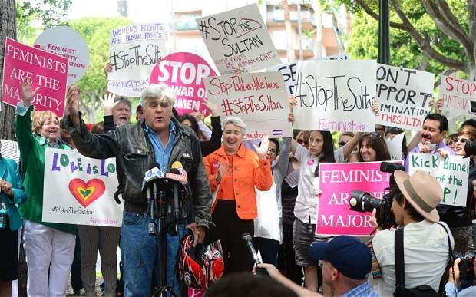
Sultanate
Sultan (f: sultana) – “strength”, “authority”, “power”
Elective govt. exists, but sultan wields broad powers
Brunei: sultanate has full power of executive branch, incl. ‘emergency powers’ since 1962

Slide 6
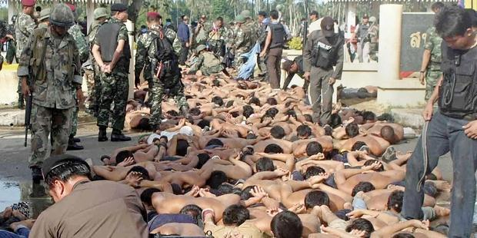
Junta
Usually military – committee of military leaders
All govt. officials appointed; elected officials suspended
Common throughout Lat.Am. after US-led coups in Cold War era
Few exist today:
Burkina Faso (since 1987, but changing now)
Thailand (2014)

Slide 7
Theocracy
‘Rule by God’ through chosen person
Affords chosen leader enormous prestige & power
Limits on power set by faith
Examples:
Vatican City
Tibetan govt. in exile
Iran

Slide 8
Theocracy: Vatican City explained

Slide 9
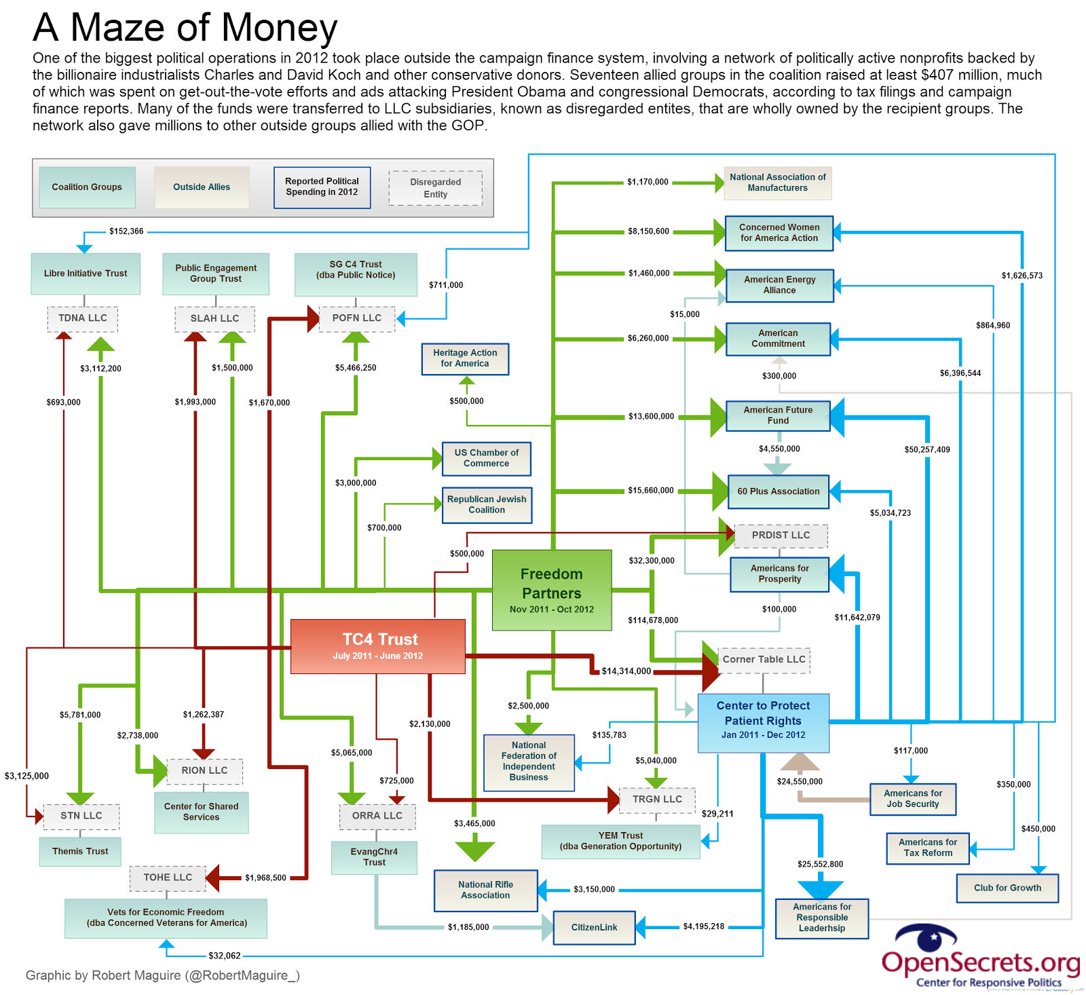
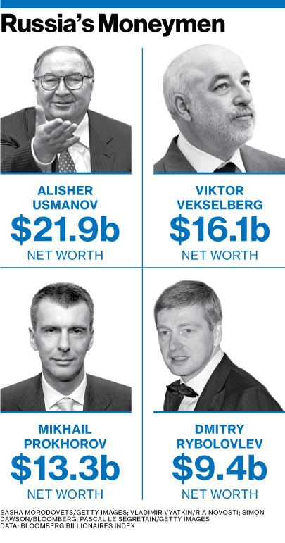
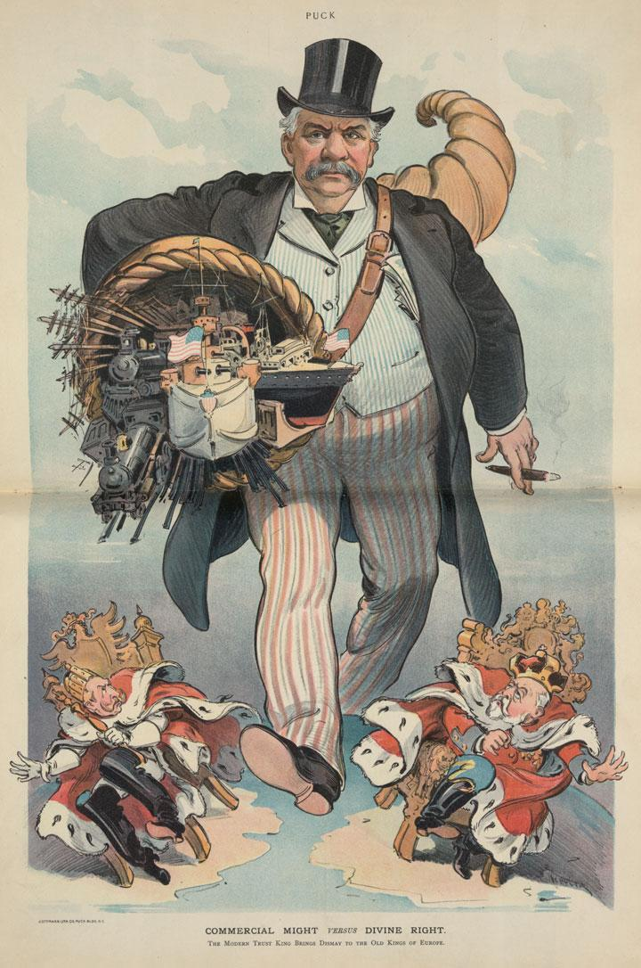
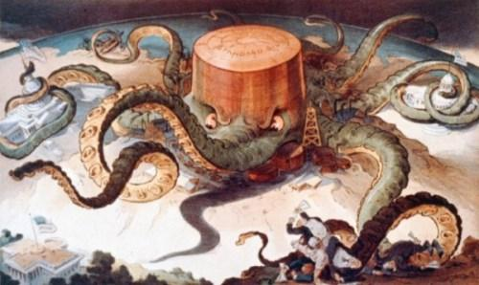
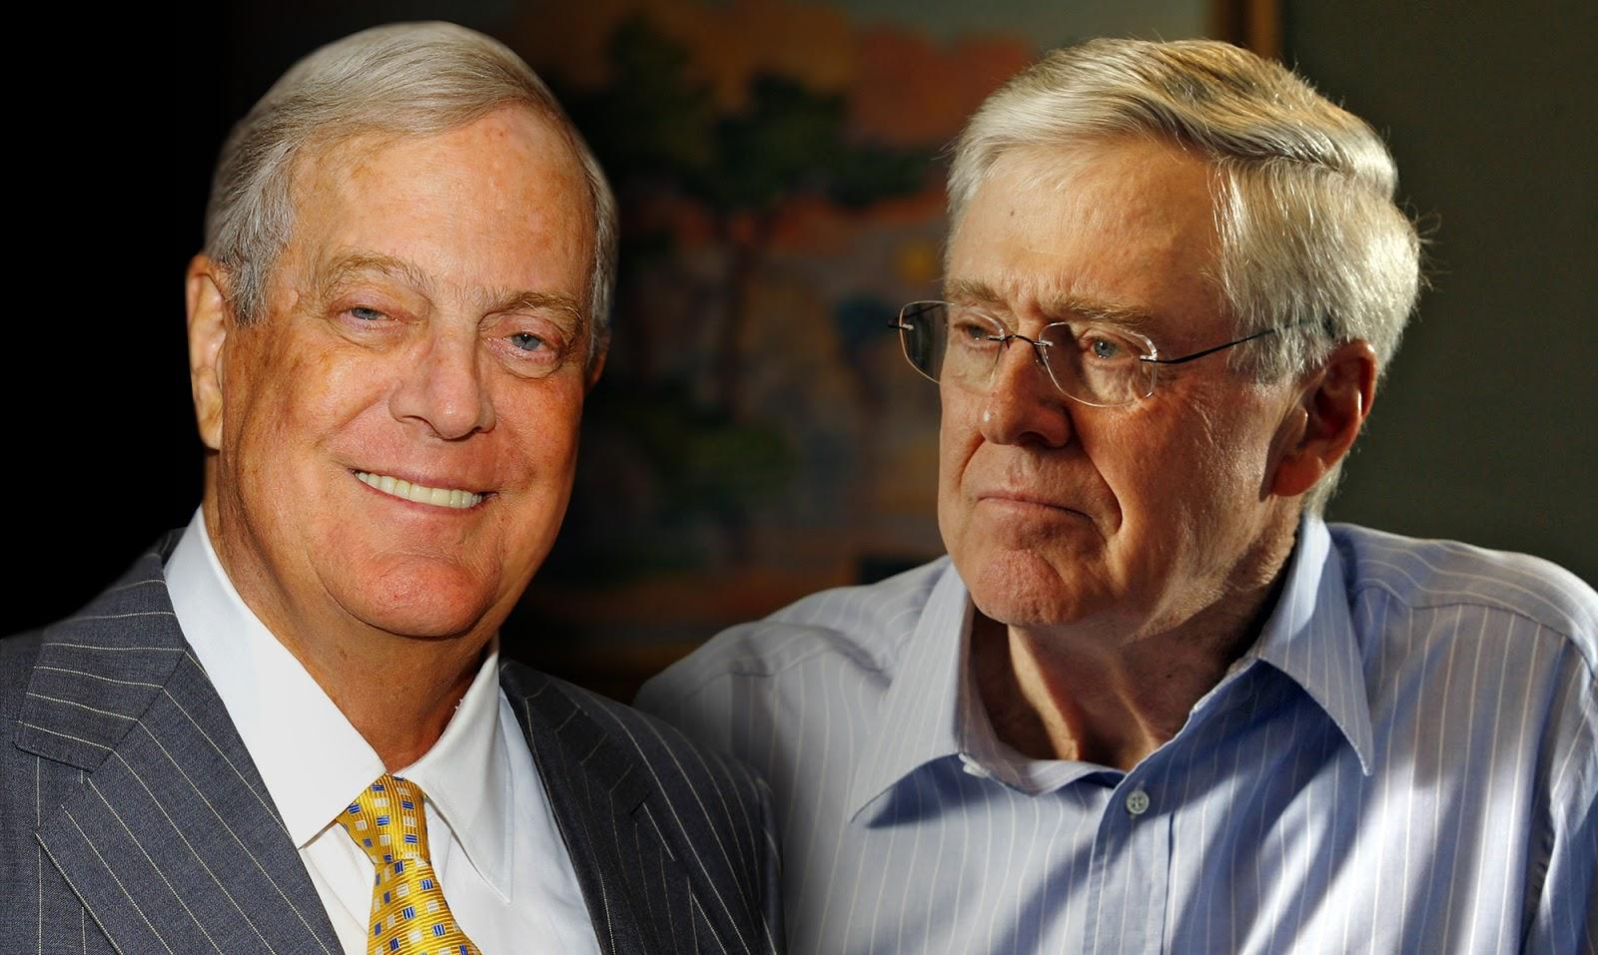
Oligarchy
Rule by few – above representative government
Royalty
Wealth (Russia)
Education (Cambodia under Khmer Rouge)
Family (Turkey)
Religion
Corporate (U.S.)

Slide 10
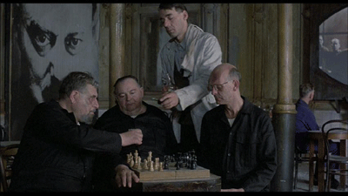
Communism
Central party (oligarchy)
Complete control over government AND economy
No private ownership
Constant wage & price controls
Lousy cigarettes, gin

Slide 11
Socialism
Can be democratic or autocratic
Powerful central government
Limits on corporate power
Private ownership

Slide 12
Parliamentary Democracy
Elected legislature
Executive branch accountable to legislature
Head of government is not head of state
Multi-party system dependent upon coalitions to est. power (proportional representation)
Power is more evenly distributed
Prime ministers maintain power by effectiveness rather than popularity
Easier to pass new laws

Slide 13
Parliamentary Democracy

Slide 14
Differences
US is a conservative nation by comparison
Our liberal parties are very conservative abroad, esp. regarding role of gov’t.
Other nations have many more political parties
Proportional Representation
Other nations’ political parties change more frequently

Slide 15
Mixed-Member Proportional Representation

Slide 16
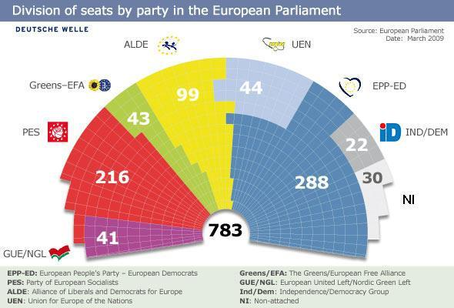
Mixed-Member Proportional Representation

Slide 17
Essential Question
What are the advantages and disadvantages of the political systems of other nations around the world?

